Slide 1
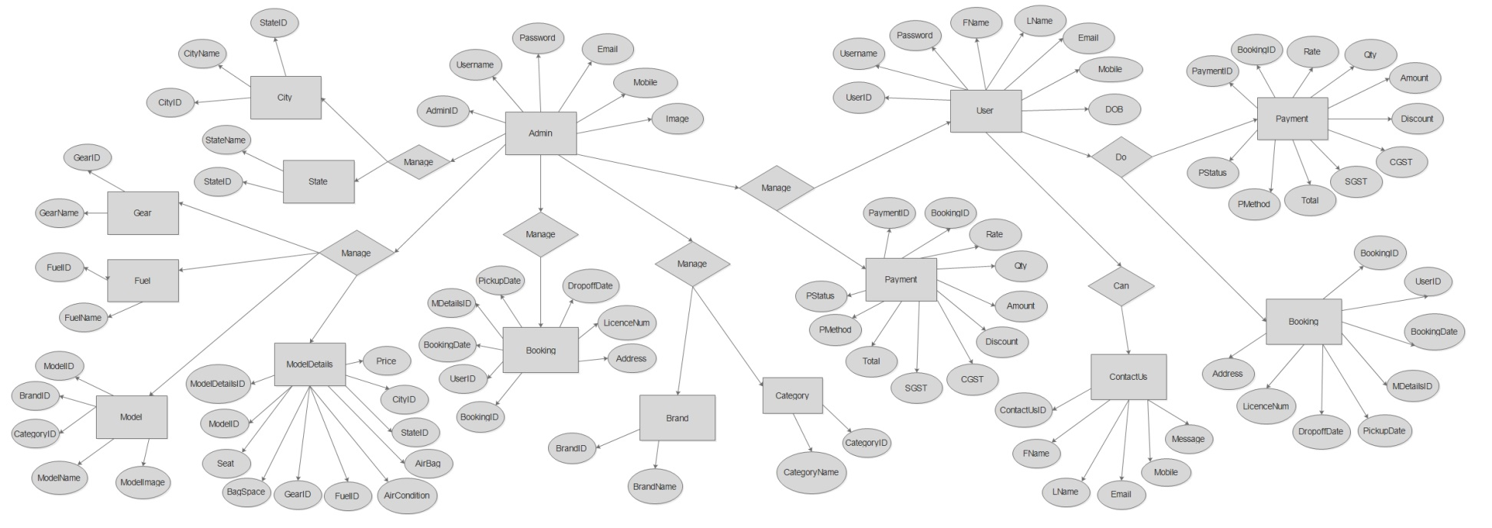
Entity Relationship Diagram

